Slide 1
Unit 3
Chapter 6
Lesson 2
Day 1
Pages 160-162

Slide 2

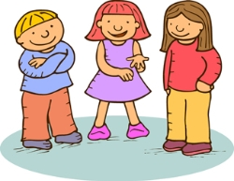
Please do now!
Write three lines describing a time when there was a rule you didn’t agree with. What was the rule? What did you do about it? What happened next?
Share with your partner.

Slide 3
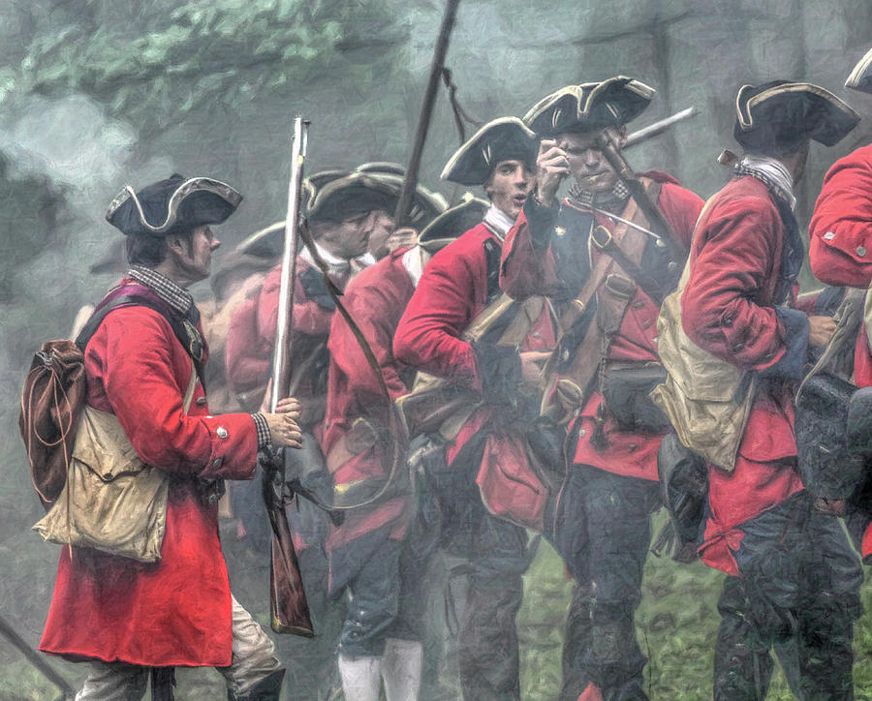
The French and Indian War and Pontiac’s Rebellion cost Britain a lot of money. The wars left Britain in debt.

Slide 4
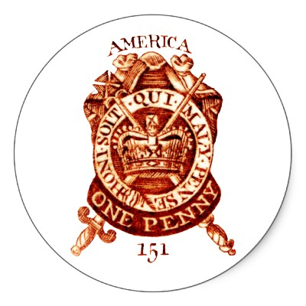
To raise money, Britain started taxing the American colonies. The colonists thought this was unfair.

Slide 5
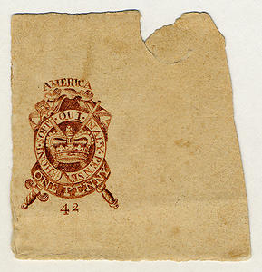
Parliament passed the Stamp Act in 1765 which was a law that said all colonial newspapers and official documents had to have a special stamp. Colonists had to pay a tax for these stamps.

Slide 6
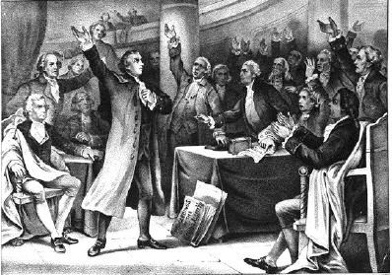
Many colonists protested the Stamp Act and refused to pay for it. It was repealed, or stopped, in 1766.

Slide 7

Then in 1767, Parliament passed the Townshend Act. This put taxes on British goods like paper, glass, cloth, and tea. Many colonists boycotted these goods.

Slide 8
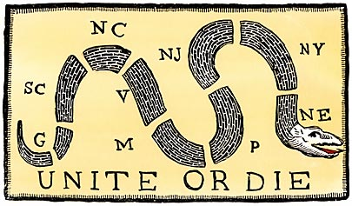
Colonists continued to get angry. Many colonial leaders knew the colonies should join together in their opposition against Britain.
Ben Franklin’s
cartoon encouraging
colonists to join
together.

Slide 9
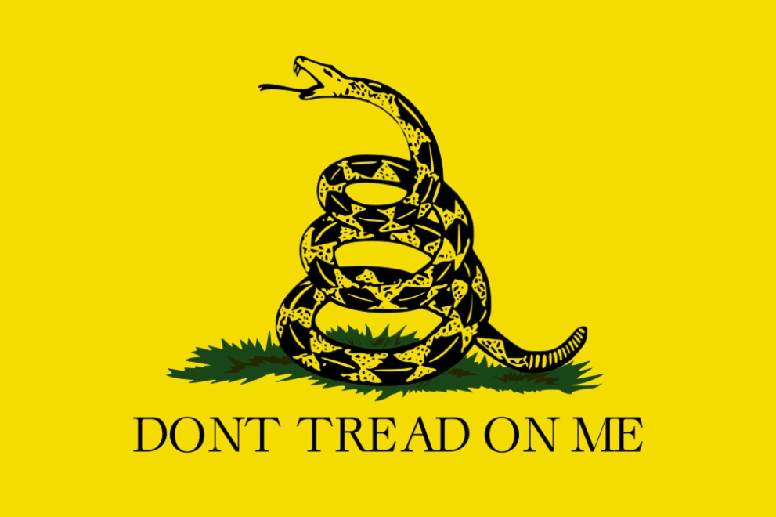
The protests continued. Many speeches and sermons were given, cartoons made, and books and pamphlets written to encourage colonists to join in the cause of liberty.

Slide 10
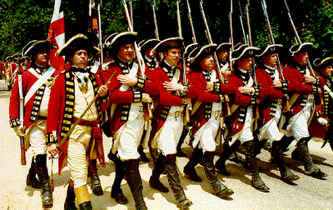
Britain sent soldiers over to America to try to keep order. Colonists and British soldiers often got into fights or arguments.

Slide 11
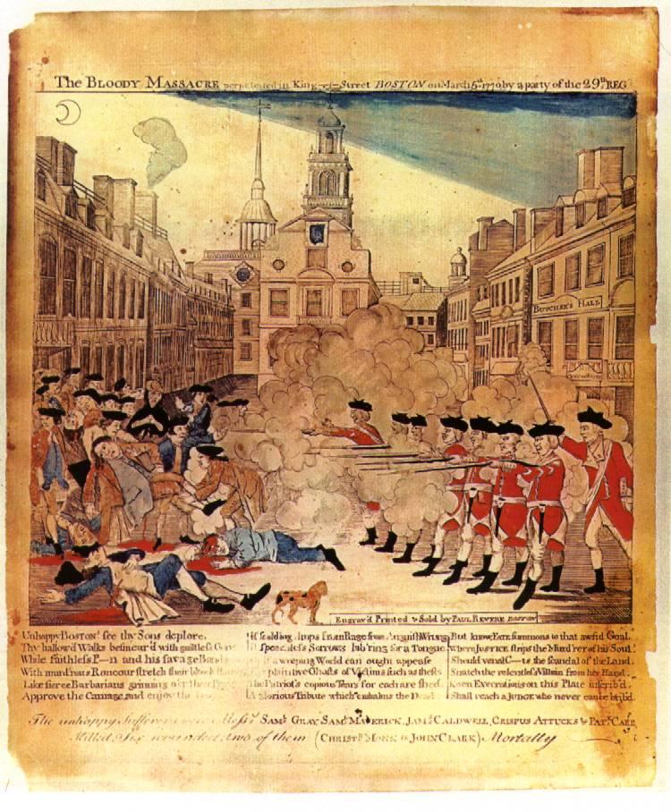
On March 5, 1770, in Boston, Massachusetts, British soldiers fired into a crowd of protesters. Five colonists were killed. This became known as the Boston Massacre.

Slide 12
Historical Fiction Analysis
Nonfiction Fiction Historical
Historical Fiction

Slide 13
Rise to Rebellion
By Jeff Shaara
Historical Fiction Analysis
Evidence of Fiction | Elements of Nonfiction

